Slide 1

Careers in Biotechnology
A presentation by faculty members and program graduates (Biotechnology) and the Career Center at MiraCosta College
October 18, 2017

Slide 2
Outline of this presentation
Overview of our local industry/careers in biotechnology (bench-level and manufacturing)
Miracosta College programs in biotechnology
  Lower division programs in Research & Development and Biomanufacturing
  Bachelor’s degree program in Biomanfacturing
Panel presentations by program graduates employed in biotechnology
Career Center services
Question/Answer session
Networking, meet and greet

Slide 3
Biotechnology
“Biotechnology is an expanding field devoted to improving human health through the research, development, testing, manufacturing, and marketing of products related to the biomedical and agricultural industries.”

Slide 4
What does that mean? It means that the work you do could result in:
discovery or manufacture of new drugs, or tests/devices for diagnosing disease
improvements to crops (e.g. disease resistance, nutritional quality, yield)
alternatives to fossil fuels or reduction of environmental hazards
lower cost, or increased availability, of critical drugs or treatments
And much, much more

Slide 5
The industry
San Diego region is home to more than 1,100 life sciences companies and more than 80 independent and university-affiliated research institutes
Employment Numbers: In 2014, life sciences accounted for 35,300 jobs in the San Diego region
Key companies
  ALMA Life Sciences BD Eli Lilly Genentech GlaxoSmithKline Illumina Pfizer ResMed
  Thermo Fisher Takeda Human Longevity Inc
  http://www.sandiegobusiness.org/our-economy/lifescience

Slide 6
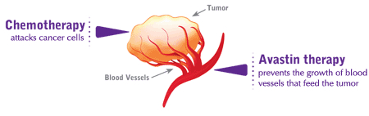
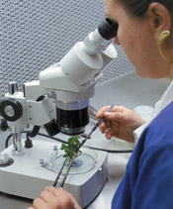

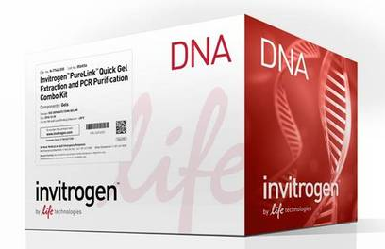

North County companies are diverse
Therapeutics: Genentech
Diagnostics: GenMark
Health Monitoring Services: Serametrix
Agricultural: Rancho Tissue Technologies
Industrial: Verdezyne
Suppliers: ThermoFisher

Slide 7
The biotechnology pipeline:
Research
Discovery
Preclinical studies
Development
Clinical studies
Scale-up
Production
Compliance
Quality

Slide 8
Where do you fit in?
Research
Discovery
Preclinical studies
Development
Clinical studies
Scale-up
Production
Compliance
Quality
Bench-level, trial and error, “discovery,” publications
Determining feasibility; interface between research and production; interdisciplinary
Large (manufacturing) scale; regulated, team-based, standardized

Slide 9
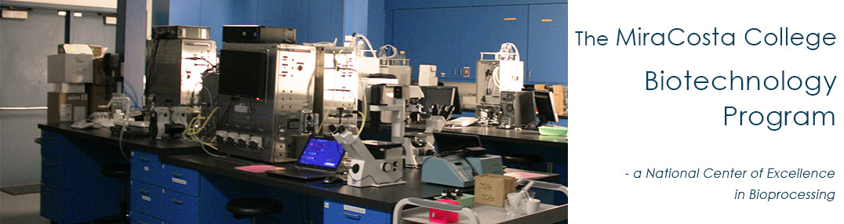
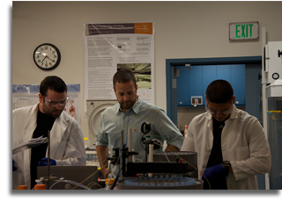
How to get there…training for a career in Biotechnology

Slide 10
Current programs:
Laboratory Skills COP (11-12 U)
  Introduction to the industry and general lab techniques; targets the novice, those trying out the field
Bioprocess Technology COA (12 U)
  Preparation for entry level employment in a regulated environment focused on the production of biologics; also used to extend skills of traditionally trained scientists already working in non-regulated settings
Research and Development Associate Degree and Certificate of Achievement (41-45 U)
  Preparation for employment in science settings focused on discovery/investigation; “bench science”. Requires more academic preparation in math, biology, chemistry; enhances skills/knowledge of students who may transfer as biology majors to a 4 year university

Slide 11
Fall 2017
New Certificate of Achievement and Associate’s Degree in Science in Biomanufacturing (40-41 U)
  Specifically fulfills requirements for advancement to the bachelors degree in biomanufacturing
New Bachelor’s Degree in Biomanufacturing
  Built on AS in Biomanufacturing
  36 U of upper division courses in the major (biomanufacturing)
  9 U of upper division general education courses

Slide 12
Where to start..
All programs begin with a solid academic foundation in STEM: general biology, math (algebra and statistics) and chemistry
Enroll in
      BIO105 (Introductory Biology: Biotechnology and Society)
      CHEM110 (General Chemistry)
      MATH64 (Intermediate Algebra)
      BTEC180 (Biostatistics)

Slide 13
Then, investigate the field of biotechnology:
Enroll in the following courses to learn more about the industry and your specific interests, all while gaining employable entry-level lab skills
  BTEC110 (Basic techniques in biotechnology)
  BTEC120 (Business & regulatory practices in biotech)
Complete general chemistry (CHEM111)

Slide 14
Define your focus:
R&D or Manufacturing???
Perhaps ask yourself the following:
  Do you like the undefined process of discovery, of trying new approaches, always moving in new directions, facing failure and regrouping, engaging in academic discussions of science, working largely unsupervised?
  Or
  Do you like knowing what needs to be done and working to ensure that it goes smoothly, identifying and troubleshooting problems, following procedures to ensure quality and reproducibility of the outcomes, actually making a product?

Slide 15
If R&D is your goal/focus:
Complete BTEC elective coursework to earn an Associate’s degree in Research and Development
Obtain an internship and/or entry level employment as a bench scientist to get real life experience
Complete additional coursework that would allow you to transfer to a university as a biology major
  Physics, calculus, majors biology (202/204)
  See Assist.org or a MiraCosta counselor

Slide 16
If manufacturing is your goal/focus:
Complete BTEC elective coursework to earn an Associate’s degree in Biomanufacturing
Obtain entry level employment in biomanufacturing,
Or
Apply for the bachelor’s degree program in biomanufacturing at MiraCosta College to qualify for advanced positions in the manufacturing sector of the biotechnology industry

Slide 17
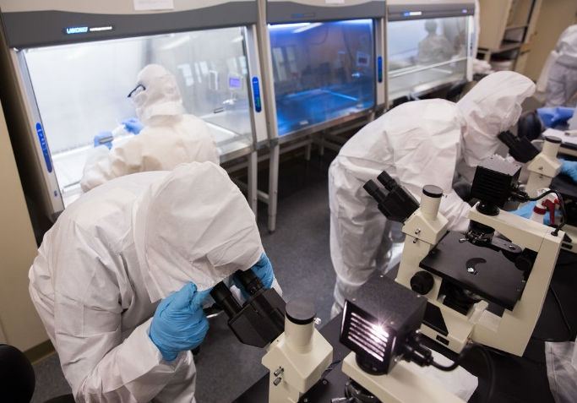
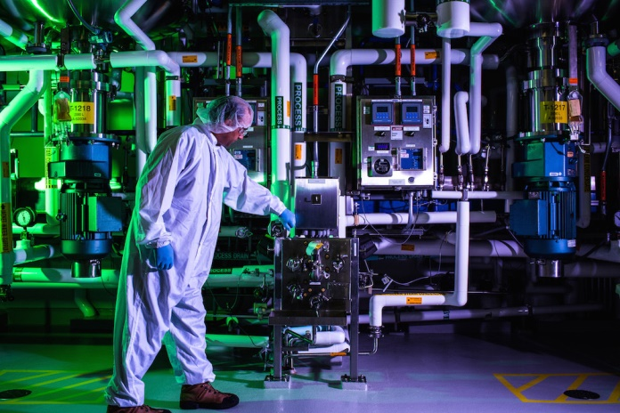
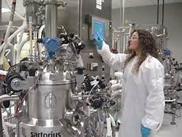
Biomanufacturing Careers
Manufacturing and Services:
  Manufacturing Technician, Associate,
  Supervisor
  Process Development Technician, Associate, Supervisor
Quality Control and Assurance:
  QC Technician, Analyst, Supervisor
  Documentation Specialist
Clinical Research:
  Regulatory Affairs Associate, Manager
Operations:
  Life Cycle Management: Product Manager
  Supply Chain and Enterprise Resource Planning/Specialist
  Project Manager

Slide 18
How to apply for the bachelor’s degree program in biomanufacturing
Begin by applying to the college using the standard online application
Applications for the bachelor’s degree program are available on the program website
Application deadline for fall 2018 is November 17, 2017 for first consideration, but applications will be accepted until the cohort (30) is full
See Kathy Thiele, program secretary, for questions regarding the application process

Slide 19
For more information:
MiraCosta Biotechnology Program brochure
MiraCosta Biotechnology website www.miracosta.edu/biotech
Info and FAQs on the bachelors degree (including eligibility requirements, application materials and cohort section process)
  www.miracosta.edu/bioman

Slide 20
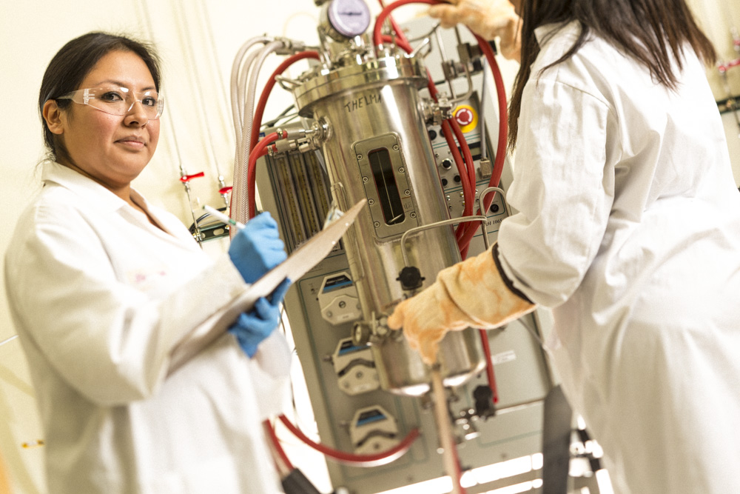
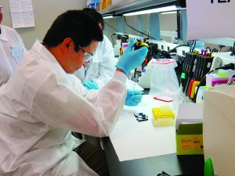
Perspectives from the industry
Panel presentation program graduates employed in the industry

Slide 21
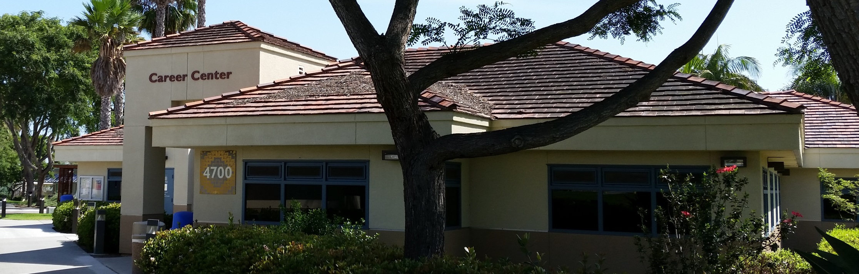
MiraCosta Career Center
Career assessment and counseling
Internship Studies & Co-op Work Experience Classes
Employment search preparation – on and off campus
760.795.6772 www.miracosta.edu/careers OC4700

Slide 22
Internships →
All students hoping to complete an internship at MiraCosta need to complete three critical steps:
Complete a class in your major
Receive a recommendation from a MiraCosta Instructor in the discipline
Have your resume approved by the Career Center
Once you are approved you can view potential internships on JAIN and easily apply online
Potential Sites
    R&D – STSI, Free Radical Technologies
    Mfr. – AG Scientific; Discussions with Genentech, Illumina

Slide 23
Questions?
For our panelists?
For the biotechnology faculty?
For the career center faculty and staff?
For our counselors?
Ask away…….

Slide 24
Thank you very much for coming!!!
Biotechnology faculty: Drs. Gail Baughman, Billyana Tsvetanonva, and Barbara Juncosa
The Career Center faculty and staff: Donna Davis, Robbi Rosen, and Nina Lovejoy
Counseling faculty: Hilda Gomez-Zinn
Please take this opportunity to have refreshments and meet our program panelists, college faculty and staff

